Slide 1
Recommender Systems

Slide 2
ID | Student Name
221416255 | Marwa Al Sultan
221436589 | Fatimah Alhadab
221443384 | Zainab Alshurayyan

Slide 3
Table of contents
01
02
03
04
Introduction
Summarization of the report
Discussion
Code Implementation
05
Code Output
06
Conclusion

Slide 4
01
Introduction

Slide 5
Introduction
Recommender systems are necessary for managing today’s overwhelming volume of information and users’ interactions with digital systems. They make recommendations smarter over time with help of algorithms and data mining techniques in accordance with users’ evolving behavior and preferences. Such systems do not only improve customer satisfaction by providing appropriate recommendations, but also enhance customer engagement and sales for the companies. Furthermore, they help in building customer retention by enhancing user experience through customization. All in all, recommender systems are crucial aspects of the modern world, as they guide targeted decisions and user experiences in the various fields.

Slide 6
02
Summarization of the report

Slide 7
Summarization of the report
Recommender systems has three methodologies:
1- Content based filtering: which recommends items based on user’s interest by using his profile.
2- Collaborating filtering: which recommends items based on preferences of similar users.
3- Knowledge based systems: which relies on specific rules and exiting knowledge about the user’s needs and item features.

Slide 8
Summarization of the report
User experience is enhanced by using recommender systems that suggest products or content based on preferences. AI techniques have improved accuracy of recommender systems, which are:
Deep neural networks
Transfer learning
Active learning
Reinforcement learning
Fuzzy techniques
Evolutionary algorithms
Natural language processing
Computer vision

Slide 9
03
Discussion

Slide 10
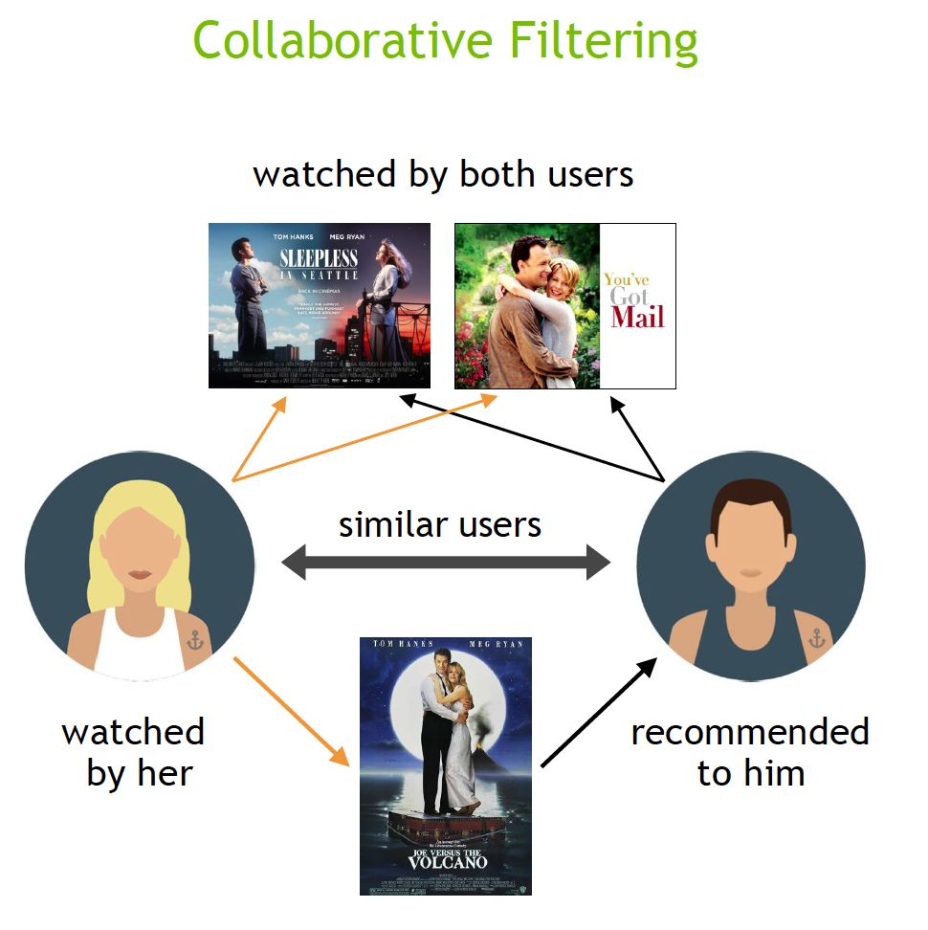
Discussion
Recommender systems play a significant role in enhancing the user experience by providing personalized suggestions. Each type of recommender system has its own advantages and disadvantages. We are focusing on collaborative filtering, which has been emphasized in the code.
Advantages of memory-based collaborative filtering:
Simplicity and efficiency
Scalability
Alleviated sparsity.
Improved accuracy.
Disadvantages of collaborative filtering:
1. Cold-start problem.
2. Lack of data.

Slide 11
03
Code Implementation

Slide 12
Description & Objective
The goal of this project is to develop a recommendation system that provides a list of 10 books that are similar to a book that a customer has read. This project will implement a collaborative-based filtering method via scikit learn's K-Nearest Neighbours clustering algorithm using the Amazon books dataset. The books data contains all the book titles, ISBNs, author, publisher and year of publication. The user dataset contains the user IDs, location and age. The ratings dataset contains user ids, ISBNs and book rating scores. All datasets are a subset of books available on Amazon.

Slide 13
Machine learning model
In order to feed the data into the machine learning model, the alphanumeric ISBN values had to be assigned unique integer IDs. This process was executed in the following steps:
Use .ravel() method to create array of unique ISBN values and store in book_ids variable.
Cast book_ids array to pandas series.
Convert book_ids to pandas DataFrame.
Reset index of book_ids, rename columns to ISBN and Book-ID.
Merge book_ids DataFrame with larger merged dataset.

Slide 14
Compressed Sparse Row Matrix (CSR Matrix)
Sparse matrices have most elements as zeroes as opposed to dense matrices which have most elements as non-zeros. The benefits of a CSR matrix is that memory required for data storage is minimized and stored in the RAM. Performing operations using only non-zero values increases the speed of the algorithm.
In the program, the CSR matrix is used to feed into our machine learning algorithm.

Slide 15
K-Nearest Neighbors
Sci-kit Learn's NearestNeighbors algorithm is an unsupervised learner for implementing neighbor searches. In the program, an execution of a brute search with a cosine similarity matrix where the algorithm normalizes the rating by subtracting the mean.

Slide 16
04
Code Output

Slide 17

Code Output

Slide 18
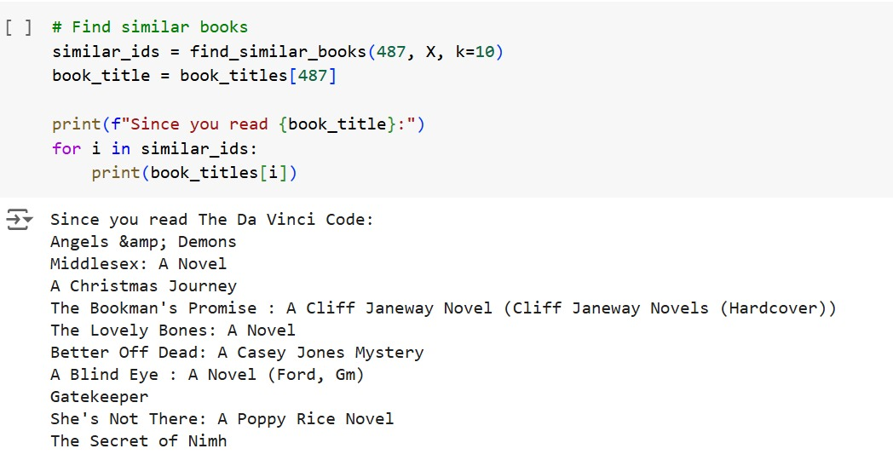
Code Output

Slide 19

Code Output

Slide 20
05
Conclusion

Slide 21
Conclusion
To conclude, recommender systems play a crucial role in enhancing user experience across various platforms by providing personalized content. By using data analysis and machine learning techniques, systems will provide products and services that satisfy user’s preferences. As artificial intelligence techniques continue to improve, the effectiveness of recommender systems will also improve and provide more relevant recommendations. By using these tools, both businesses and users can benefit and get a better online experience.

